Slide 1





Level Up Your Django Performance: Identifying and Taming N+1 Queries
Mohammad Ahtasham ul Hassan
(Works at Arbisoft)
mohammad-ahtasham
Shafqat Farhan Ahmed
(Works at Arbisoft)
shafqat-farhan-87677791

Slide 2
Agenda
Overview of ORMs with respect to relational databases
Importance of performance in software applications
What is N+1 problem
Performance impact of N+1 problem
Identifying N+1 queries (an example)
Taming N+1 queries
Considerations and key takeaways
Questions?

Slide 3
Overview of ORMs with respect to relational databases
Automatic query generation
Django ORM operates on a lazy querying principle
The database is only accessed when the query is actually evaluated
N+1 query problem is particularly relevant to ORM and relational database queries
It can lead to performance issues

Slide 4
Importance of performance in software applications
Why Performance matters?
User Experience
Timeoutes
Random crashes/Memory overloads
Search Engine Rankings
Impact on Customer Retention
Side effects of ORM on performance
Abstraction overhead
Increased Memory usage
N+1 problems

Slide 5
What is N+1 problem?
When do N+1 queries occur?
Foreign Key Relationships
Reverse Foreign Key Lookups
Many-to-Many Relationships
Templates with ORM queries
Serializers with ORM queries
Why doesn’t the ORM handle itself?
Performance: Lazy loading helps to minimize the initial database query size
Complex relationships
Flexibility: Allows developers to optimize queries based on the specific use case

Slide 6
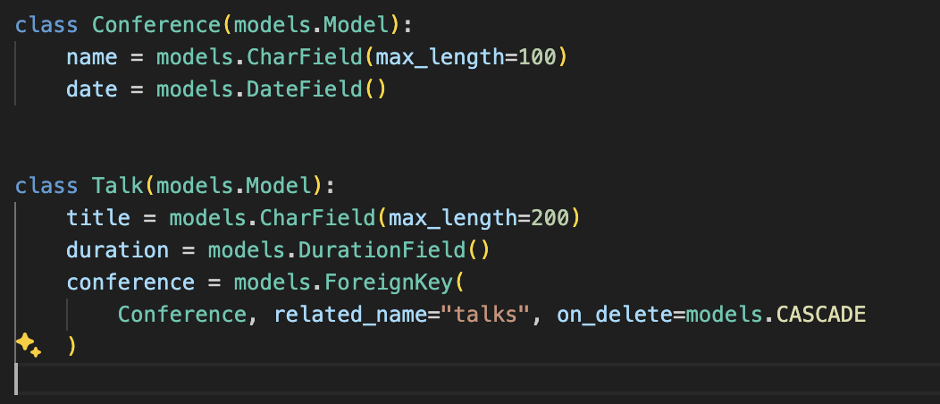
What is N+1 problem? (contd.)
Code example:

Slide 7
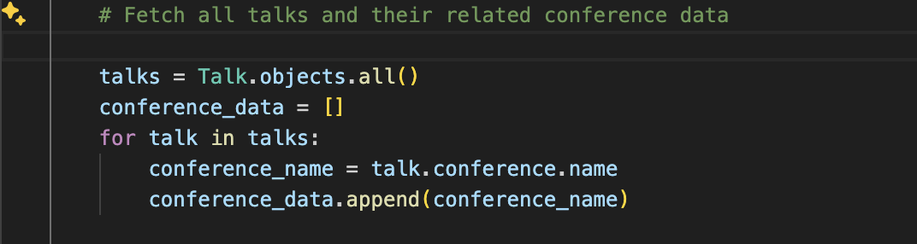
What is N+1 problem? (contd.)
Code example:

Slide 8
Performance impact of N+1 problem
Increased database round trips for each query
Degraded user experience
Inefficient query execution
Frequent API timeouts

Slide 9
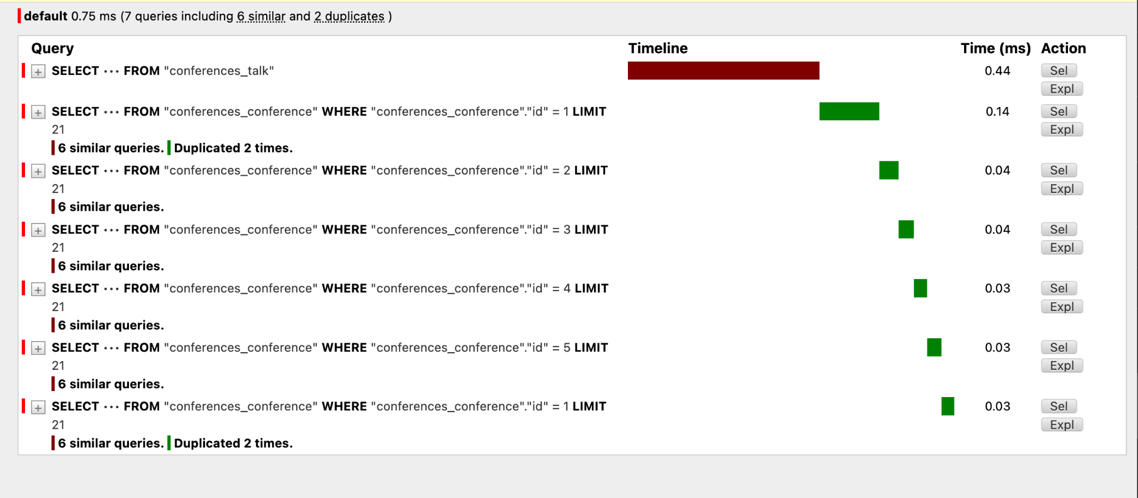
Identifying N+1 queries (an example)
Using Django Debug Toolbar
SQL query logging

Slide 10
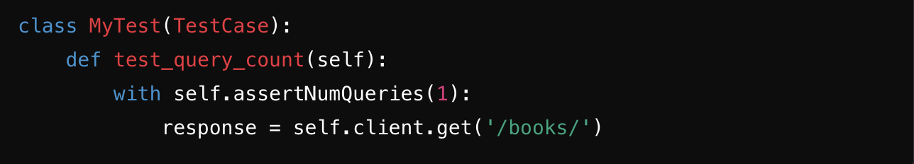
Identifying N+1 queries (contd.)
Code Reviews
Testing
Use unit tests to test for executed queries
Other options?

Slide 11
Taming N+1 queries
select_related()
For foreign key relations
Loads related objects in one query
prefetch_related()
For many-to-many relations or reverse lookups
Performs an additional query and then join in Python

Slide 12
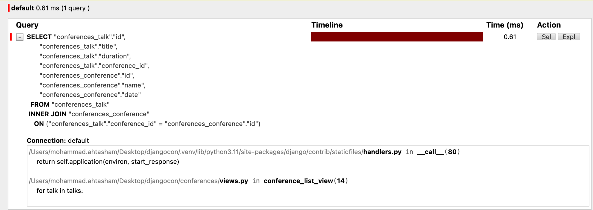
Taming N+1 queries (contd.)

Slide 13
Considerations and key takeaways
The performance impact is minimal with small datasets
Solving the N+1 problem may cause ripple effects in large and complex datasets
Prefetching large datasets can lead to increased memory usage
Avoid prefetching related data if there's no specific use case (mindful data fetching)
Django REST Framework (DRF) serializers fetching relational data can lead to N+1 query issues
Resources:
https://docs.djangoproject.com/en/4.2/ref/models/querysets/#select-related
https://docs.djangoproject.com/en/4.2/ref/models/querysets/#prefetch-related

Slide 14
Questions?

